Slide 1
Denguego!
cZ2006 Software Engineering project
Team: Black and yellow
Team Members:
Anil Ankitha
Chen Xueyao
Shyam Sundar
Wang Kangxin
Wong Ze Ming

Slide 2
TABLE OF CONTENTS
01
02
03
Motivation and goals
Use Case Diagram
AND Functionalities
Target users and future goals
04
05
06
Specific USE CASEs, CLASS AND SEQUENCE DIAGRAMS
TESTING
SYSTEM ARCHITECTURE AND DESIGN PATTERNS

Slide 3
Motivation and Goals
01

Slide 4
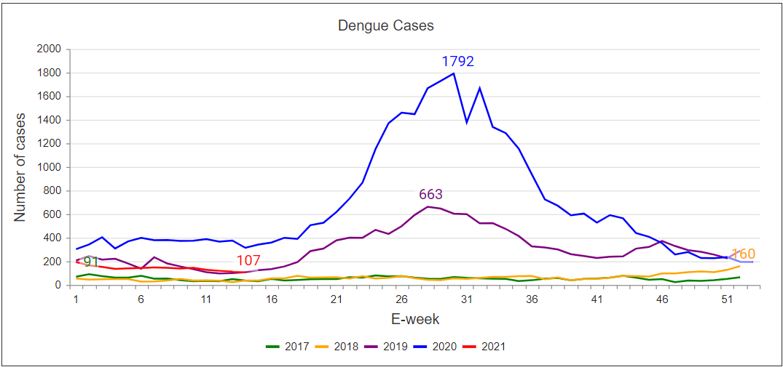

Slide 5


MOTIVATIONs and goals
Based on statistics that were collected between 2020 and 2021, we found out that dengue has caused MORE deaths than Covid-19 in Singapore.
>

Slide 6
Target Users
02

Slide 7
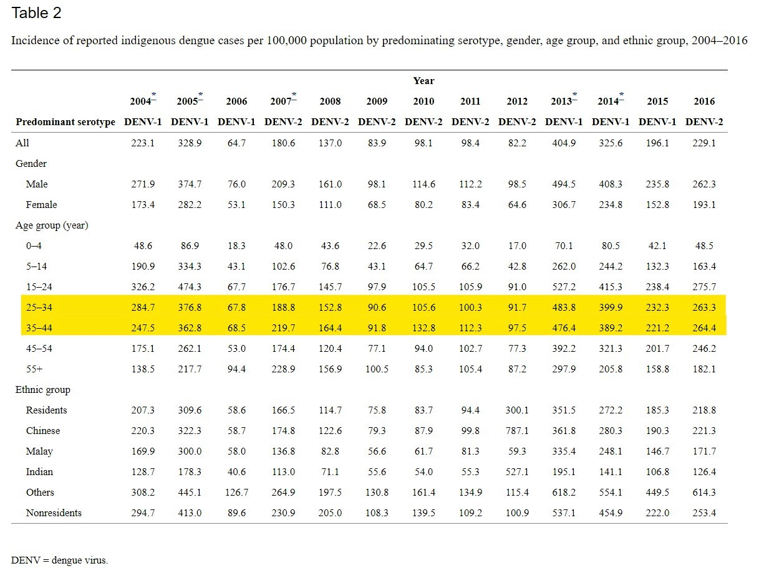
Generally targeted towards middle age users
Adults were more affected by the Dengue infection with the highest incidence rates in the age group 25-44.

Slide 8
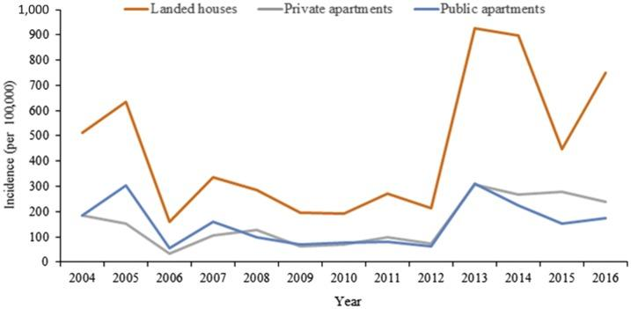
People residing in landed property show higher incidence rates
Probable Reason: Area maintenance done by property owners VS employees for HDB and condominiums
Application targeted towards such users as well

Slide 9
03
Use case diagram
Functionalities

Slide 10
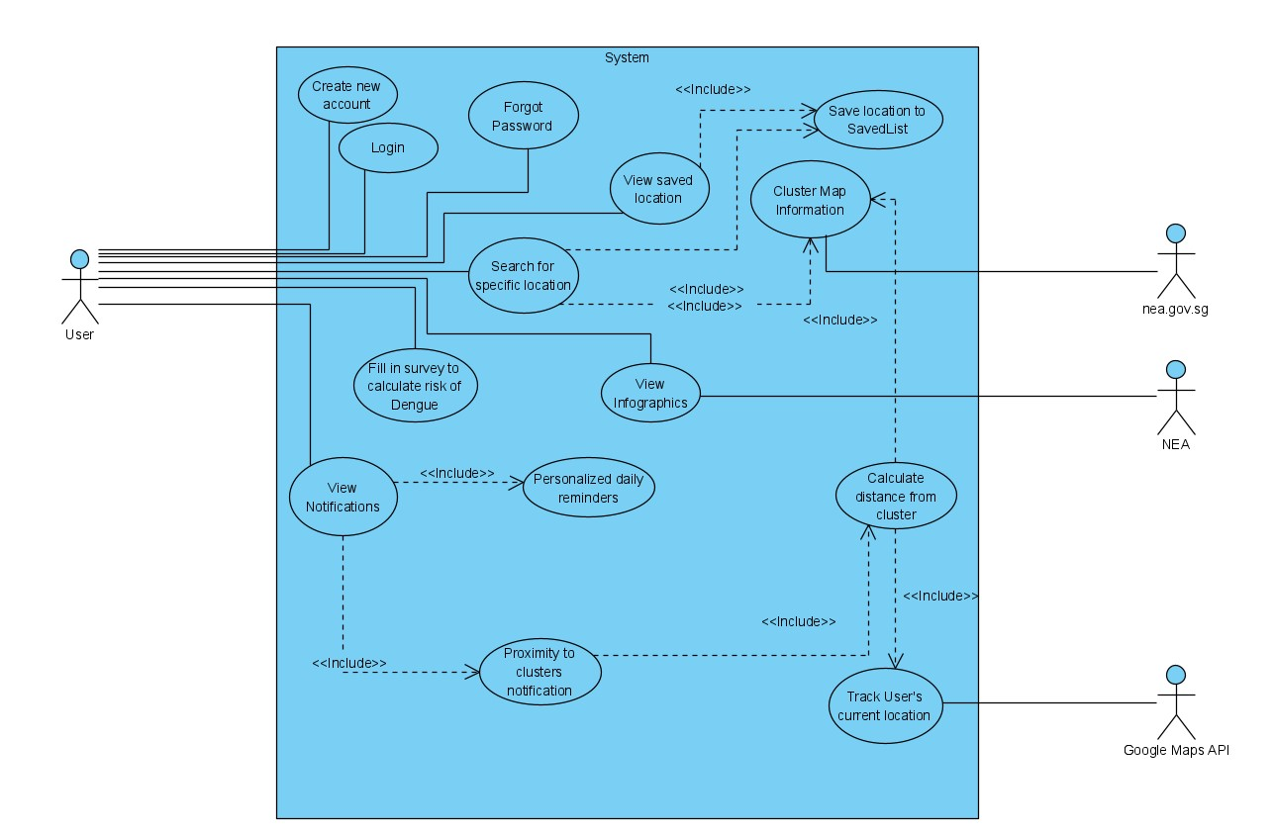
Use case diagram
System features
User Login
User Registration
Map of Dengue Clusters
Dengue Risk Calculator
Risk Reducing Measures

Slide 11
Specific USE CASEs, Class diagram
Sequence diagram
04

Slide 12
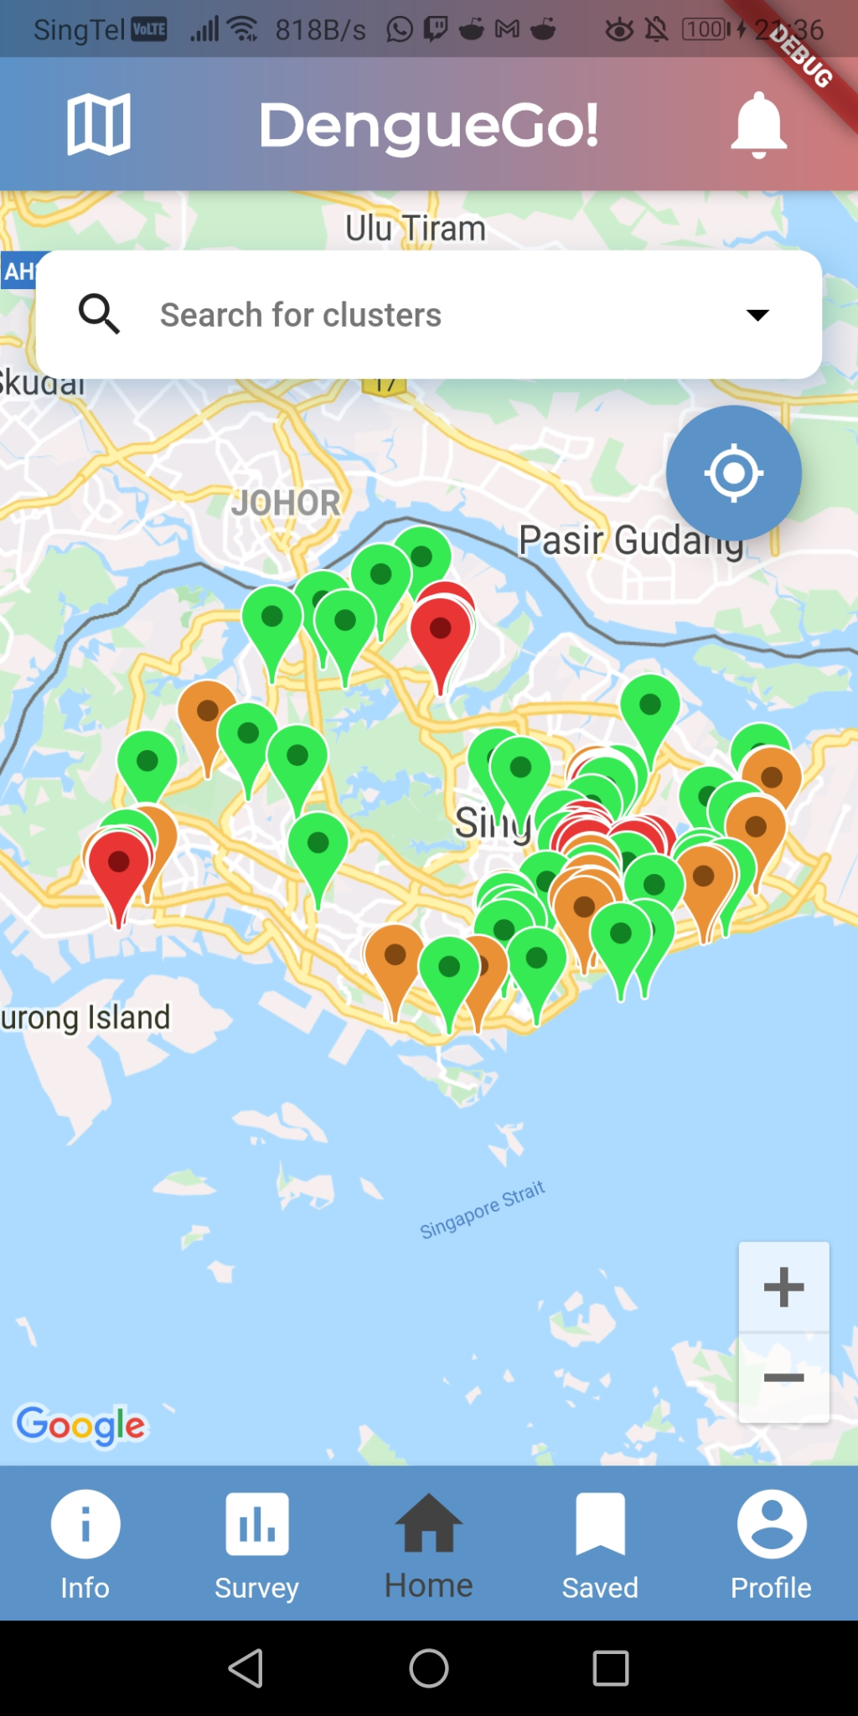
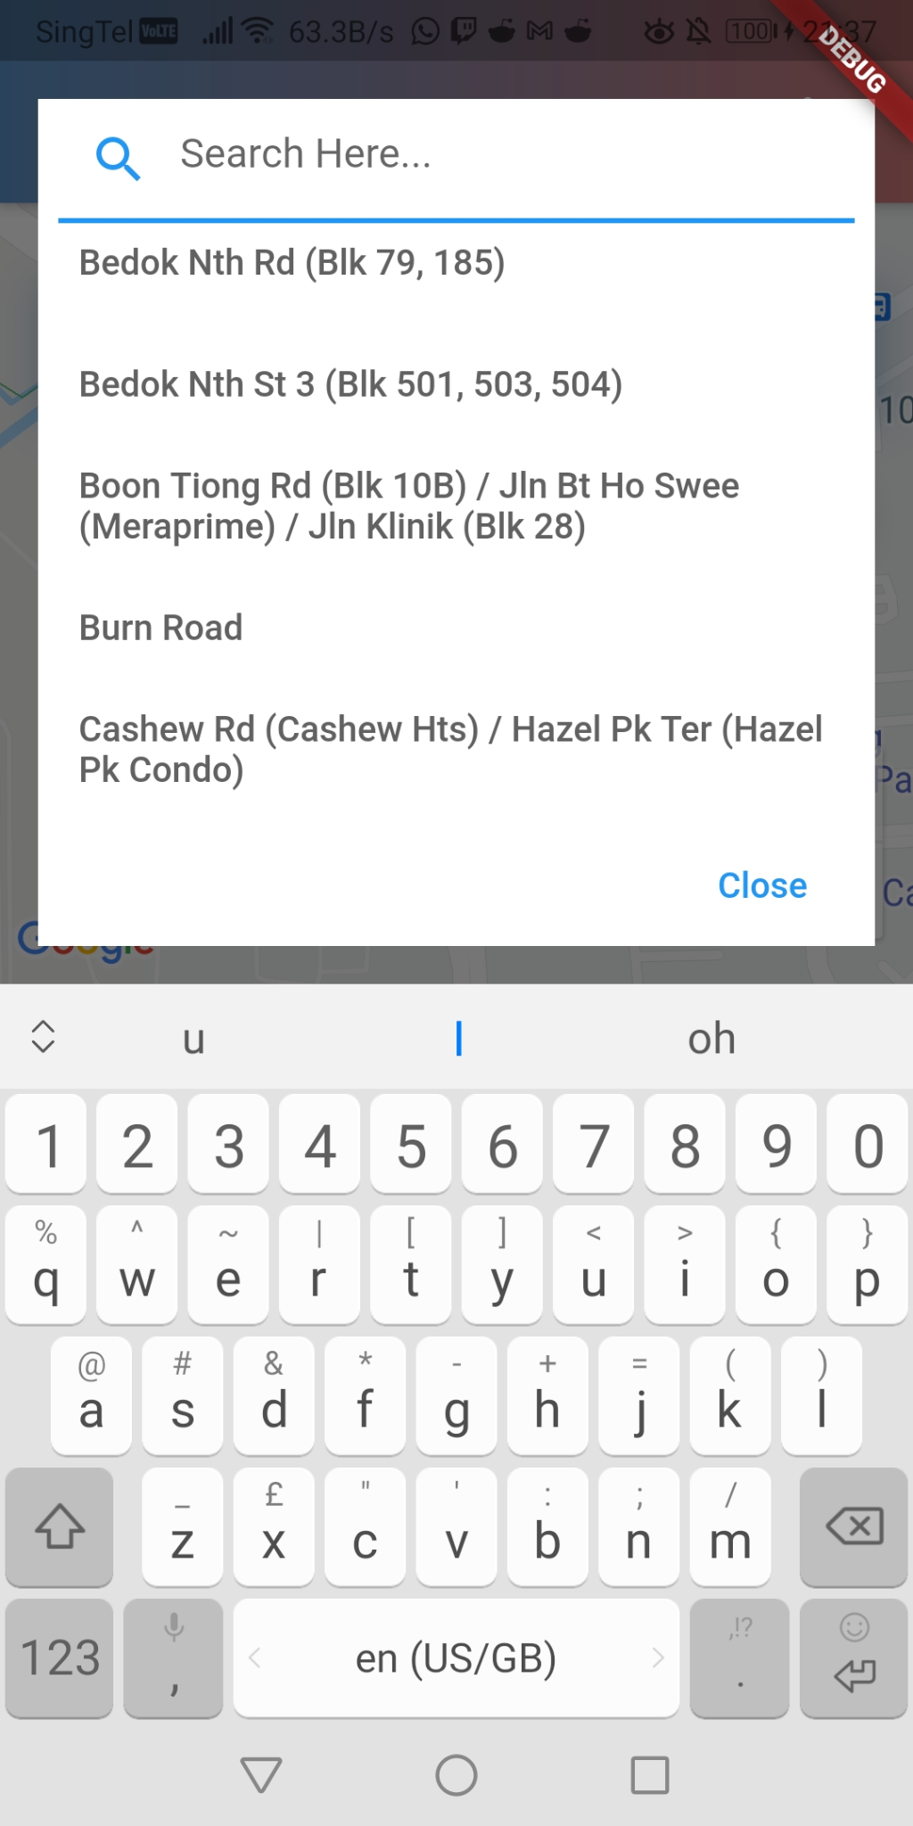
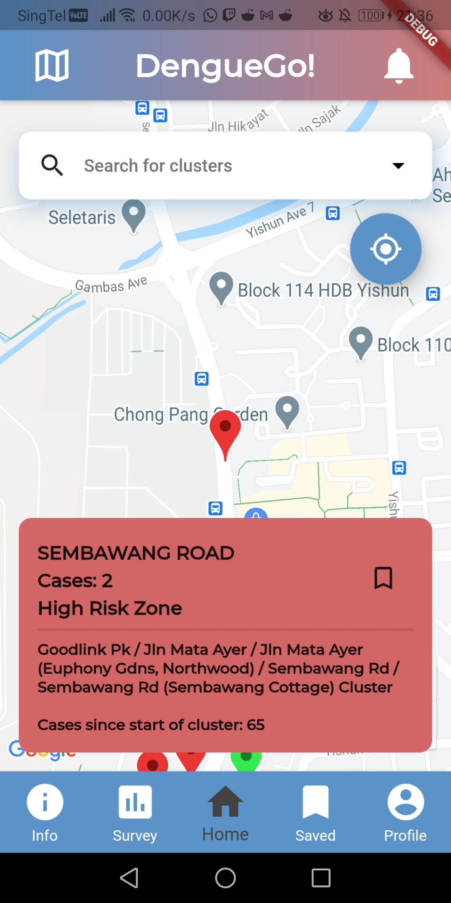
Functionality - map of dengue clusters

Slide 13
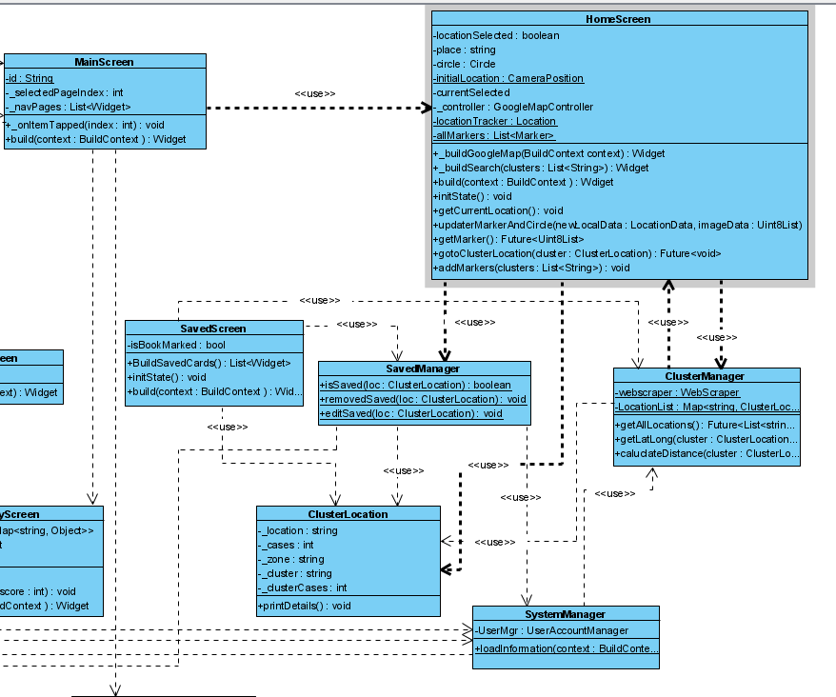
Class DIAgram

Slide 14
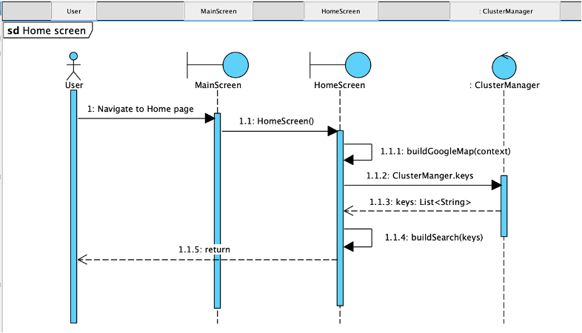
sequence diagram

Slide 15
05
System architecture
Design patterns

Slide 16
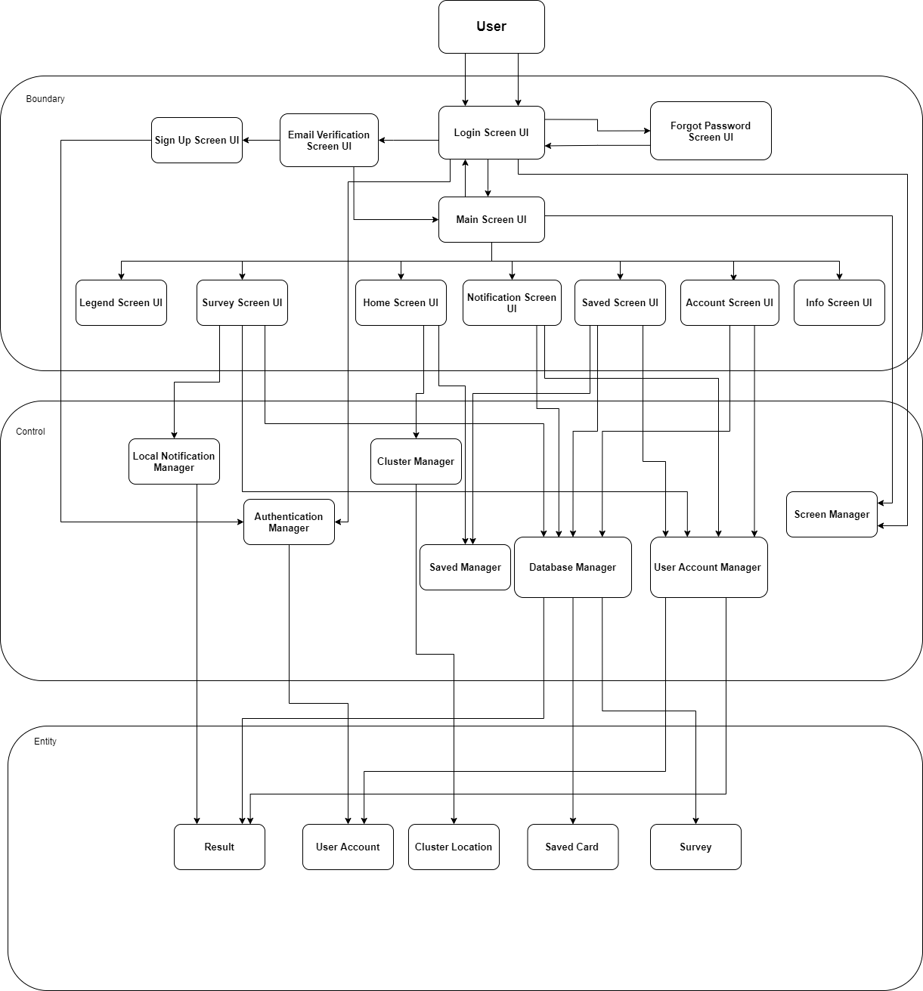
System Architecture
Layered Architecture
Layers: Boundary, Control, Entity
Advantages:
Segregation of the program
Added security
Simplicity
Consistency
Allows parallel working
Disadvantage considered: Performance

Slide 17
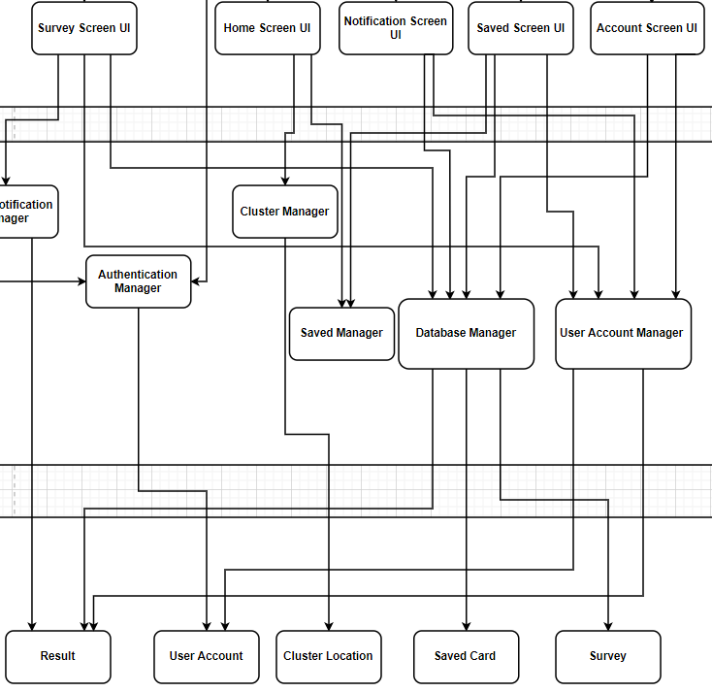
Design patterns
Boundary, Control, Entity
Factory Pattern: Localise logic for instantiation
Observer Pattern: Loose coupling
Strategy Pattern: Interchangeability

Slide 18
Good SOftware Engineering practices
SOLID->Single Responsibility Principle
Don’t Repeat Yourself(DRY)
Github, Microsoft teams

Slide 19
06
Testing

Slide 20
BLACK BOX TESTING
Functionality tested |  | Test Cases
Account | Sign In | Combinations of valid and invalid input for email and password fields.
 | Sign Up (1): Verify OTP | Combinations of valid and invalid input for email and OTP
 | Sign Up (2): Register new account | Combinations of valid and invalid input for ‘name’ and ‘password’ fields.
 | Forgot Password | Combinations of valid and invalid inputs for ‘email’ and ‘password’ fields.
 | Change Password
Notes:
To start off, for black box testing, we tested the sign in, verify OTP, register new account, forgot password and change password account functions. The test cases consisted of a combination of valid and invalid inputs for email, password, name and or OTP fields.

Slide 21
BLACK BOX TESTING
Functionality tested |  | Test Cases
Survey |  | Various combinations of input that will return different levels of risk based on score
Cluster Information |  | Varied cluster selection that will return the corresponding cluster information and the associated degree of risk.
Saved Clusters |  | Addition and removal of clusters to user’s ‘Saved’ list.
Notes:
We also tested the survey and cluster map functionalities. For survey, we used various combinations of answers that will return different levels of expected risk based on score. For the displayed cluster map, we selected various locations of clusters to test whether the expected cluster information and its degree of risk is provided.

Slide 22
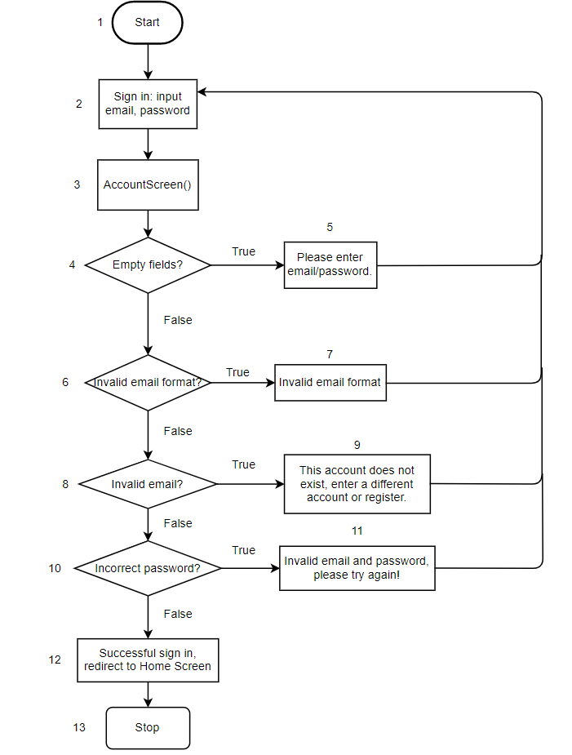
WHITE BOX TESTING - SIGN IN

Slide 23
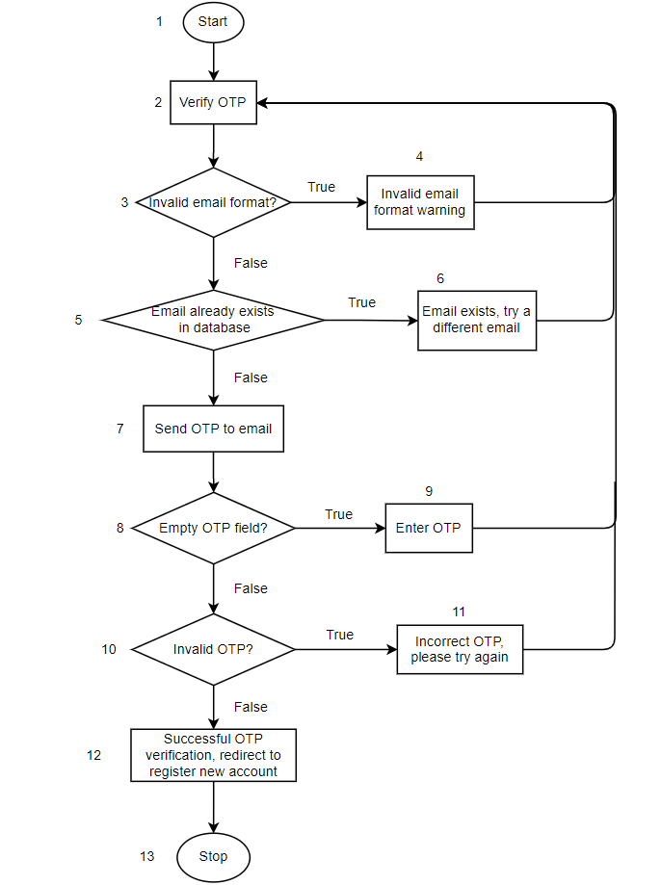
WHITE BOX TESTING - VERIFY OTP

Slide 24
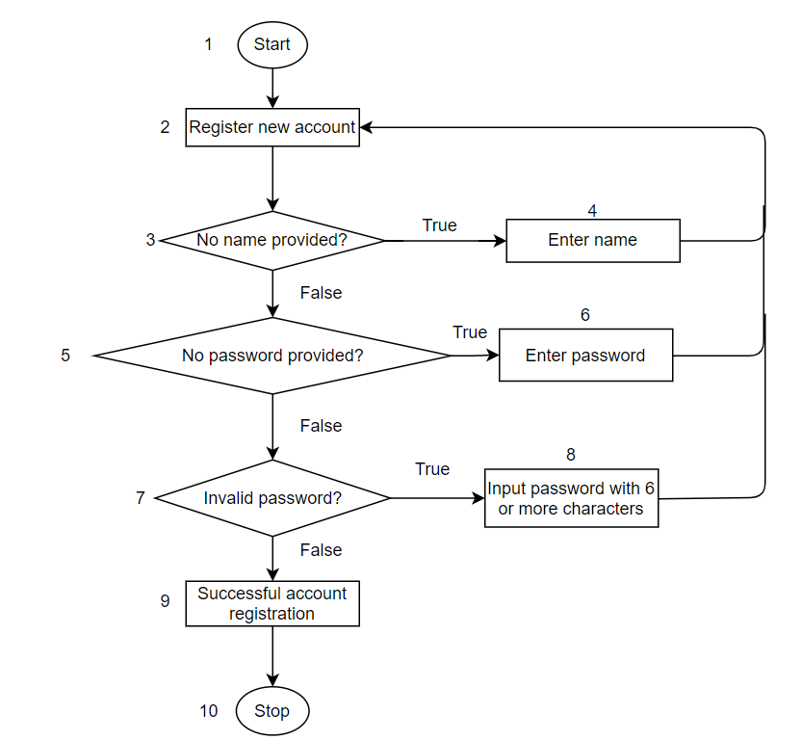
WHITE BOX TESTING
REGISTER NEW ACCOUNT

Slide 25
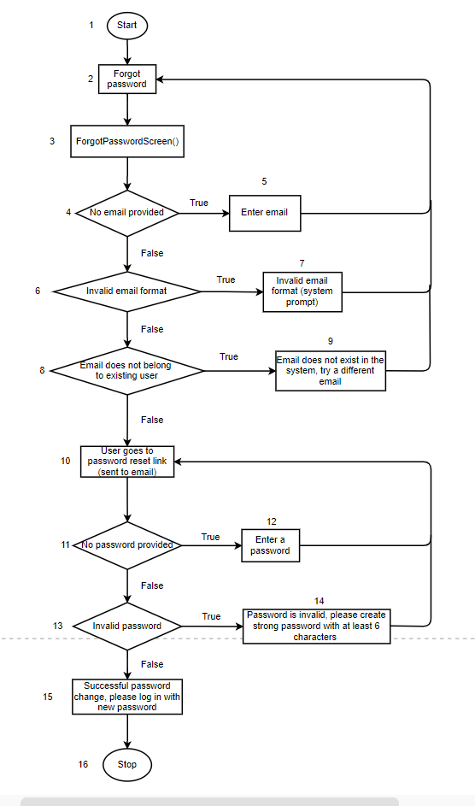
WHITE BOX TESTING
forgot password

Slide 26
WHITE BOX TESTING
forgot password

Slide 27
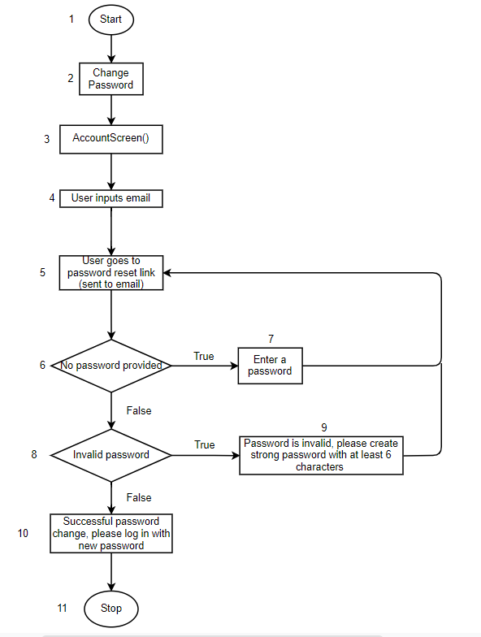
WHITE BOX TESTING
Change password

Slide 28
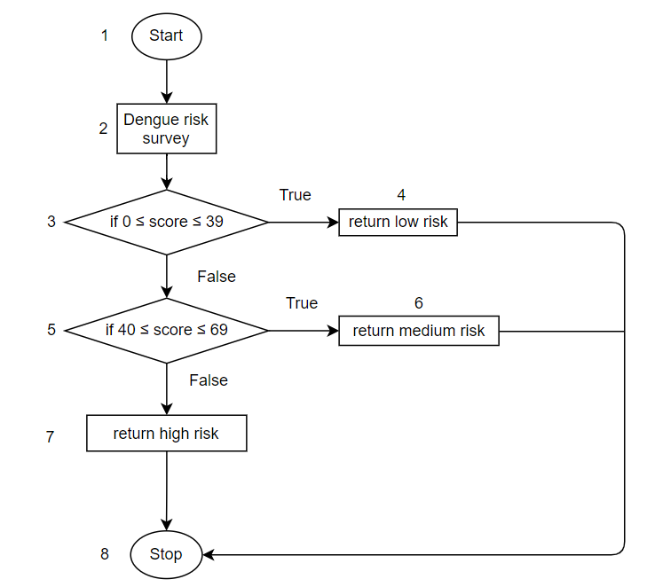
WHITE BOX TESTING
Dengue risk survey

Slide 29
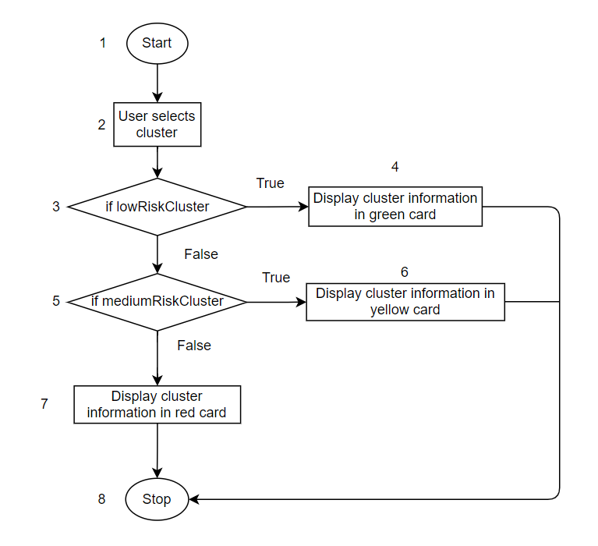
WHITE BOX TESTING
Cluster info

Slide 30
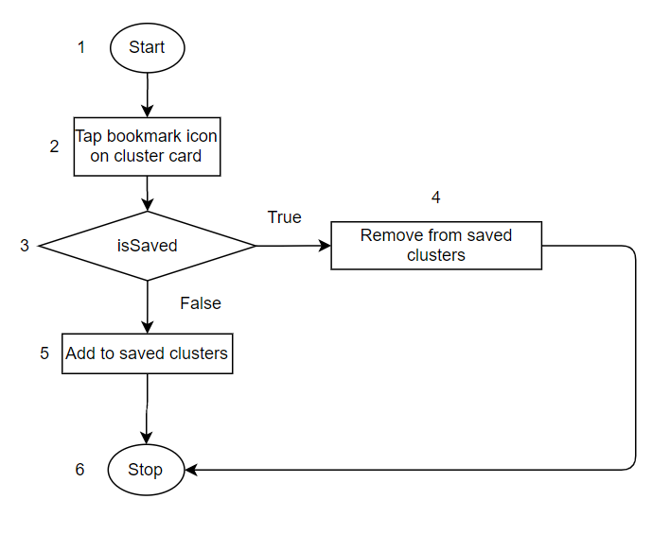
WHITE BOX TESTING
Saved clusters

Slide 31
DEMO
Notes:
Demo: diff inputs for sign in etc +
Cluster (search by typing + scroll and select)
Cluster show info
Show marker zoom in zoom out
Show track current location
Show saving clusters

Slide 32
REFERENCES
https://www.ncbi.nlm.nih.gov/pmc/articles/PMC6085773/#:~:text=Adults%20were%20more%20affected%20by%20dengue%20infection%2C%20with%20the%20highest,0.05)%20(Table%203).
Khalik, S. (2020, November 19). More people have died from dengue than from Covid-19 in Singapore this year. Straits Times.
https://www.straitstimes.com/singapore/health/more-people-have-died-from-dengue-than-from-covid-19-in-singapore-this-year

Slide 33
THANKS!
Do you have any questions? shyamsundarko@gmail.com
juliaxkimbab@gmail.com

